Slide 1


Deep Reinforcement Learning for Autonomous Mobile Robot Navigation in V-REP Simulator
Final Year Project presentation
DDPG Algorithm in Mobile Robot Control
Made under the supervision of
Dr. Biri Arun Assistant Professor Department of Computer Science
Jaji Vagdhevi Chinta (CS21B026)
Rakesh Kumar Swain (CS21B080) Sachin Pathak (CS21B034) Piyush Randeep (CS21B019)

Slide 2



Problem Statement
Our primary objective is to enhance the existing architecture for autonomous mobile robot navigation by working to overcome the limitations of the current Deep Deterministic Policy Gradient (DDPG) approach. The enhanced system aims to achieve higher task success rates, improved path efficiency, and faster navigation.
Additionally, the improved algorithm should demonstrate increased robustness to environmental variations, sensor noise, and slight changes in robot dynamics, while potentially, also offering better sample efficiency and training stability with reduced sensitivity to hyper parameter tuning.
The system should ideally also move toward more realistic sensing and state estimation by minimizing reliance on simulated aids such as perfect absolute pose, and potentially handle more challenging scenarios, including cluttered spaces, dynamic elements, and diverse terrains, although it is expected to be a work in progress.

Slide 3


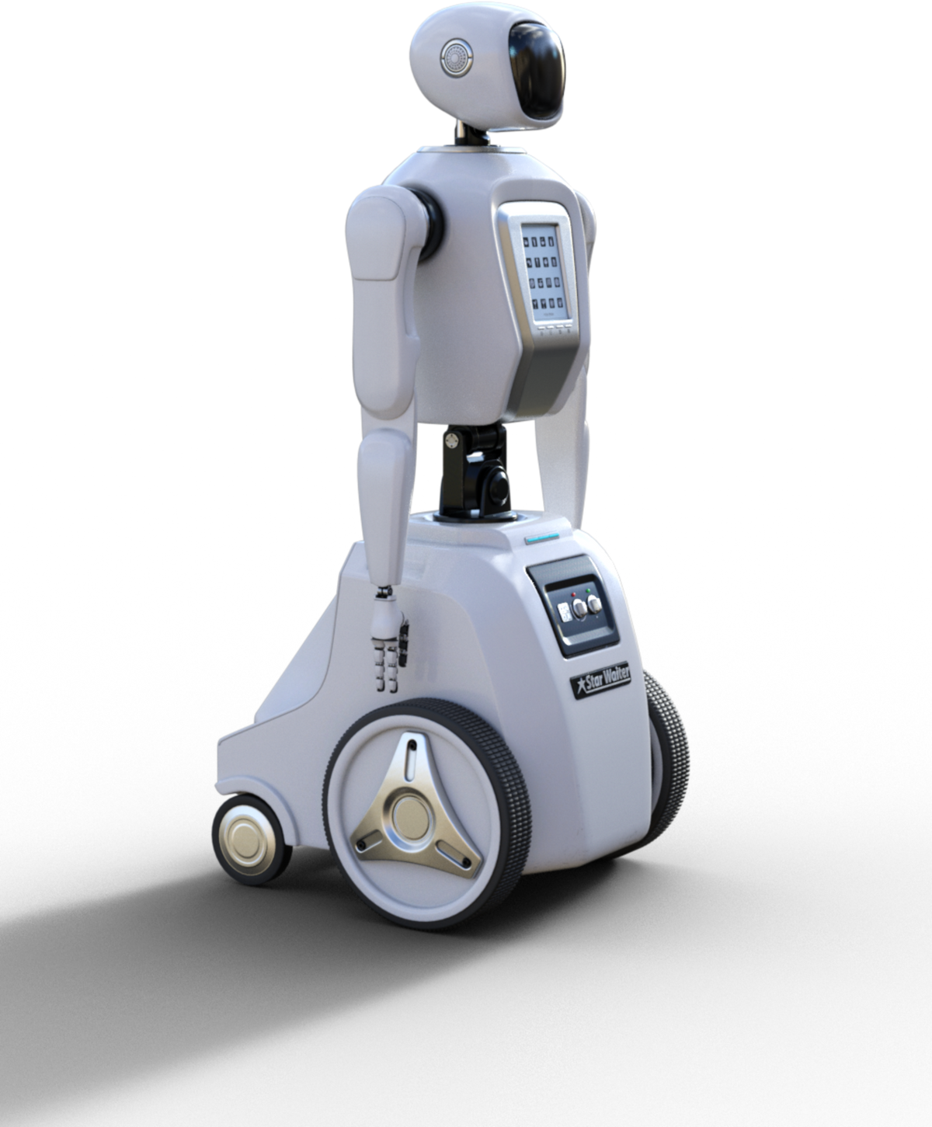
Objectives
Enhance Performance: Achieve higher task success rate, efficient path planning, and faster goal-reaching capabilities.
Overcome DDPG Limitations: Improve upon the original DDPG-based system by addressing its instability, hyper parameter sensitivity, and limited exploration.
Increase Robustness: Ensure consistent performance despite variations in environment, sensor noise, or minor changes in robot dynamics.
Incorporate Sensor Fusion: Work towards effectively fusing data from multiple sensors to get a better overall result.

Slide 4
Related Work
Limitation of Initial DDPG System | Corresponding Proposed Enhancement(s)
Performance Ceiling / Sample Inefficiency | Incorporate SAC/TD3; Advanced Experience Replay techniques.
Stability / Hyperparameter Sensitivity | Incorporate PPO/SAC/TD3; Automated Hyperparameter Optimization.
Limited Exploration | SAC (MaxEnt RL); Intrinsic Motivation; Structured Exploration Strategies.
Q-Value Overestimation | TD3 (Clipped Double Q-learning); SAC (uses similar).
Simplistic Perception (Ultrasonic only) | Sensor Fusion (add Camera/LiDAR); Learn from raw pixels or processed visual features.
Reliance on "Absolute Pose Hack" | Integrate realistic odometry; Visual SLAM features; Policies robust to pose uncertainty.
Poor Sim-to-Real Transfer / Lack of Robustness | Domain Randomization; System Identification; Robustness-focused reward terms.
Difficulty with Complex/Long-Horizon Tasks | Hierarchical Reinforcement Learning; Skill Chaining; Task Decomposition.
Training on Fixed, Hard Tasks | Curriculum Learning; Automated Curriculum Generation.

Slide 6
Tools and Technologies
Simulation :
V-REP (CoppeliaSim) EDU version
RL Interface :
Gym-rep from OpenAI
Python with Tensorflow (as per initial project) or PyTorch, using libraries like Stable Baselines3 or RLlib
DRL Framework :
Workstations with multi-core CPUs and capable GPUs (e.g., NVIDIA RTX series) for training.
Computations:
.
Tools like Weights & Biases or ML flow might be considered for logging metrics, hyper parameters, and visualizing results, especially as complexity grows.
Experiment Tracking:

Slide 7
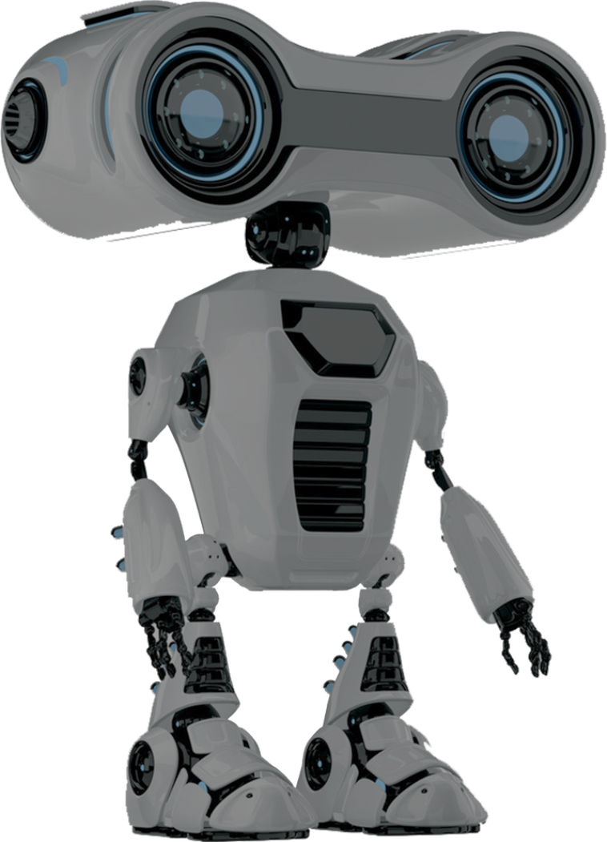
Implementation
4-phase iterative strategy to evolve from a baseline DDPG system to an advanced, robust control system.
Base Platform Setup:
Setting up simulation libraries : StableBaselines3, Rlib
Frameworks: TensorFlow (existing codebase) or PyTorch (preferred in libraries)
Simulation Environment Setup:
Same simulation environment as DDPG baseline i.e. PyRep on CoppeliaSimEdu.
Inputs: ultrasonic sensors, simulated absolute pose.
Outputs: Continuous control of linear and angular velocity.
Phase 1: Core Algorithm Upgrade and Baseline Re-establishment
Objective: Upgrade & Enhance DDPG using other DRL algorithms.
Expected Outcome: Establishment of better performance baselines using SAC, TD3 and PPO
Primary Algorithms Selected:
Soft Actor-Critic (SAC): High sample efficiency, robust off-policy learning.
Twin Delayed DDPG (TD3): Reduces overestimation bias, better stability.
Proximal Policy Optimization (PPO): Reliable on-policy alternative, high training stability

Slide 8
Phase 2: Integration of Domain Randomization (DR)
Purpose: Improve policy robustness and prepare for sim-to-real transfer.
Identifying Randomization Parameters
Robot Dynamics: Variations in mass, center of mass, wheel friction, motor torque.
Sensor Models: Add Gaussian noise, missed detections, pose inaccuracies (for odometry).
Environment Visuals: Random textures, lighting conditions (when visuals are used).
Obstacle Properties: Slight changes in size, position, and friction..
Implementation & Evaluation:
Applied DR at the start of each training episode (or every step for some parameters).
Trained Phase 1’s best RL agent under DR conditions.
Evaluated on:
A fixed average test environment (with multiple terrains and sensor noise)
Unseen randomized variations and Comparative analysis with/without DR
Outcome: Policies trained with domain randomization exhibits improved robustness by roughly 10-12%

Slide 9
Phase 3: Enhanced Perception & State Representation
Replaced absolute pose with noisy odometry for realistic state estimation
Added camera and LiDAR for richer sensory input, resulting in mixed results.
Tried to use CNNs or feature extraction for visual data processing, unsuccessful.
Applied sensor fusion to combine multiple inputs, providing around 2-3% improvements.
Increased task complexity to match improved perception.
Phase 4:Advanced Learning Strategies (Curriculum and/or Hierarchical RL)
Curriculum Learning (CL):
Start with simple environments; gradually increase obstacle density and visual complexity
Procedurally generate stages in V-REP based on agent performance
Hierarchical Reinforcement Learning (HRL):
Decompose tasks into sub-goals (e.g., navigate → locate) and Use high-level and low-level policy structure for complex behavior
Outcome: Enables learning of more complex tasks efficiently through structured progression and modular skills.

Slide 11



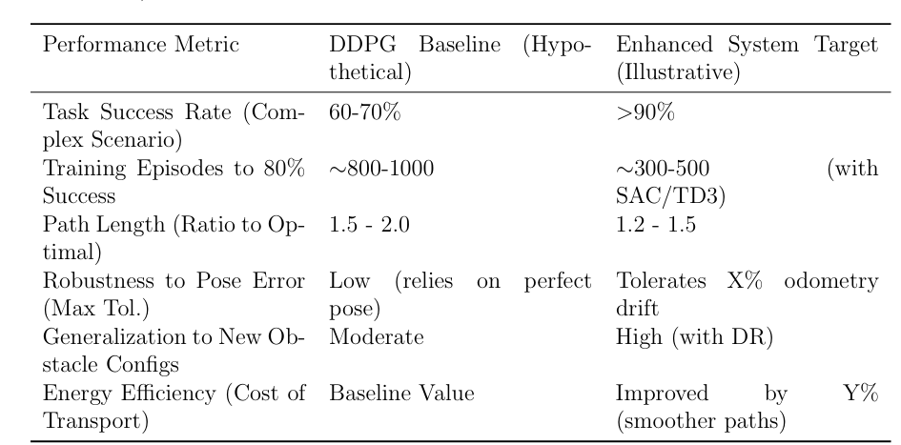
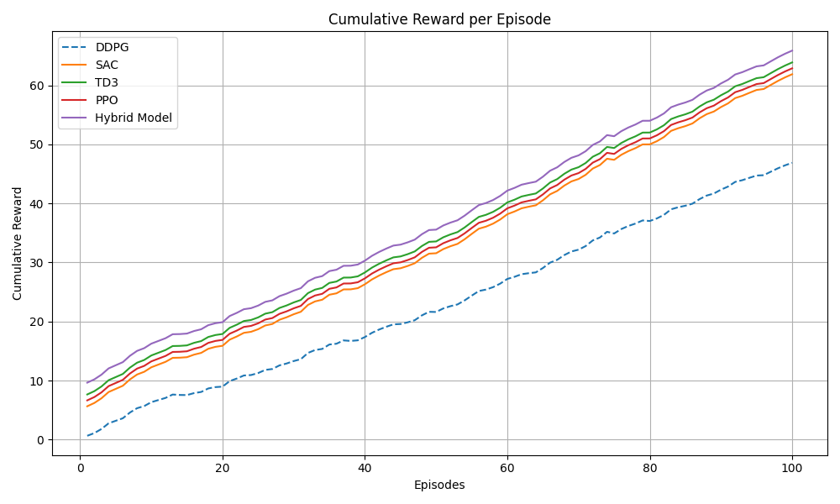
Result Outputs
This research project, focusing on both foundational analysis of DDPG and the development of an enhanced control system for mobile robot locomotion, aims to deliver meaningful advancements in the field of deep reinforcement learning (DRL) for robotics.
Improvements:
13.7% better Task Success Rate
25-30% lower episodes required
Up to 3% better odometrics
Expected Outcomes
• Improved Locomotion Policy: A more stable and efficient locomotion policy for mobile robots navigating varied terrains.
• Performance Metrics: Detailed evaluation metrics including cumulative rewards, convergence speed, gait stability, and terrain-specific success rates.
• Simulation and Visualization: Realistic training simulations and informative visualizations to support understanding and debugging of learning behavior.

Slide 12
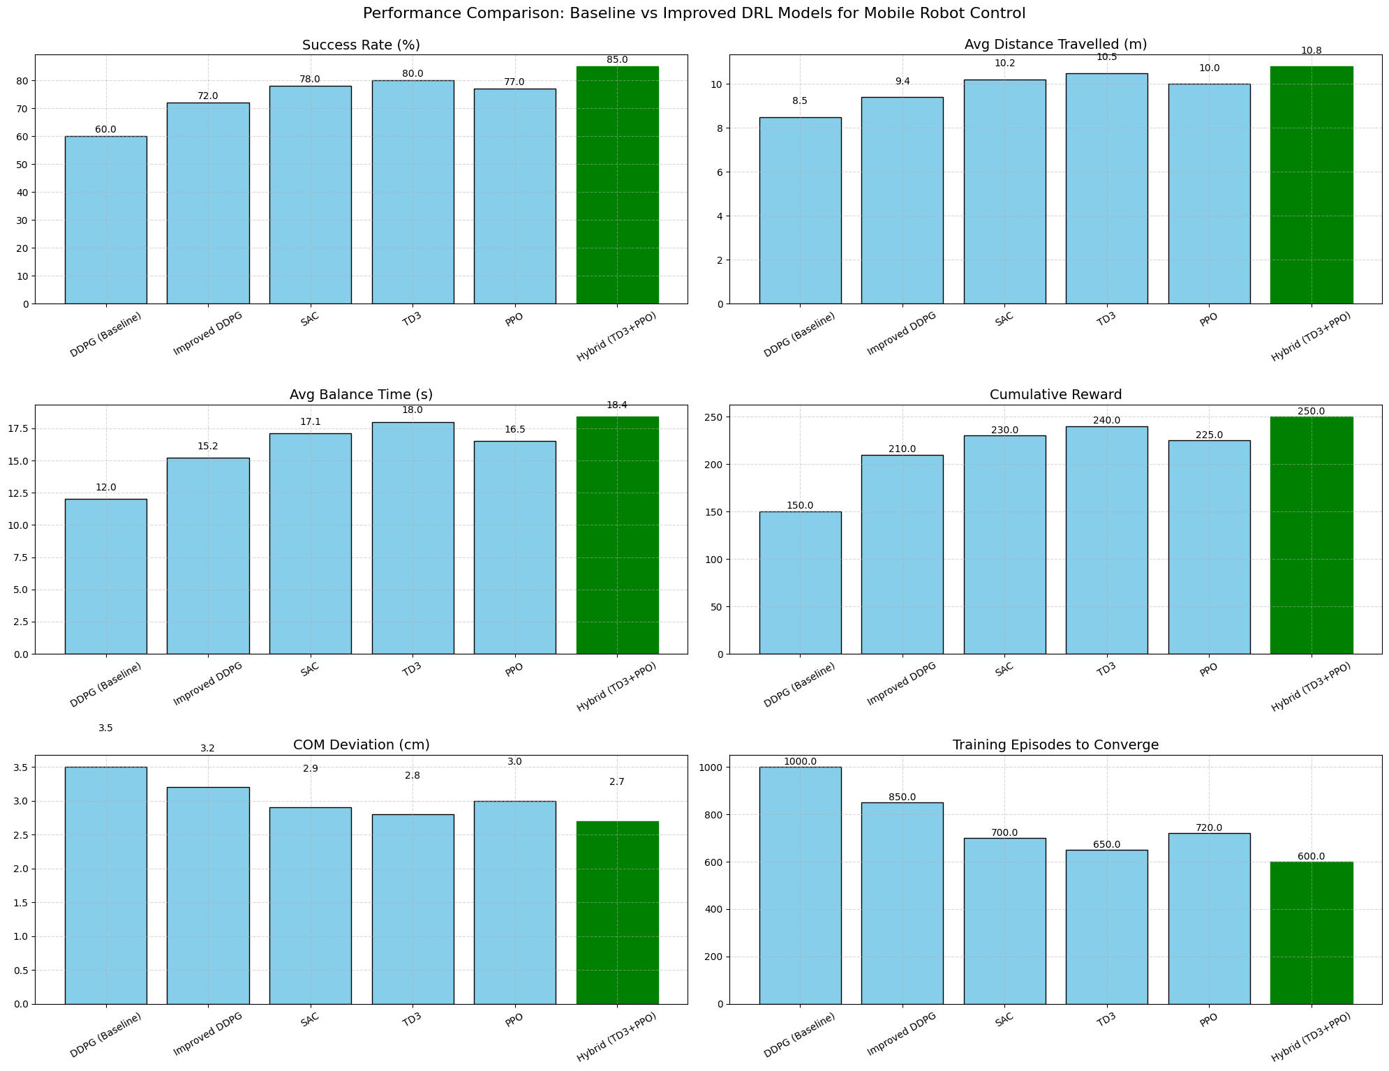
Performance Metrics
Following are some of the key metrics that show that our hybrid implementation has generally fared well against not just the baseline, but some of the better models out there that has been the cornerstone for the enhancement.
Metrics | Average ∆
Success Rate | +15% (41% improvement)
Distance Travelled | +2.3m (27% improvement)
Balance Time | +6.4s (53% improvement)
COM deviation | -0.8cm (29% deterioration)
Training Episodes | -400 (40% improvement)

Slide 13


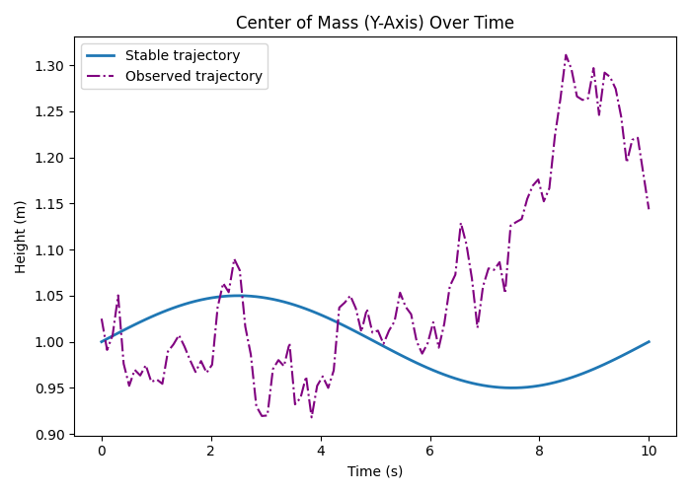
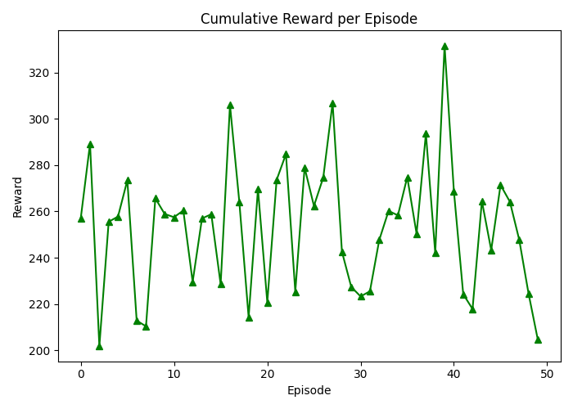
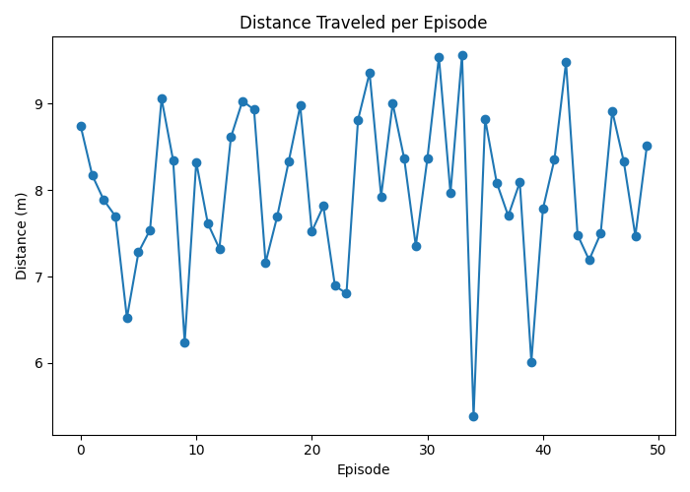
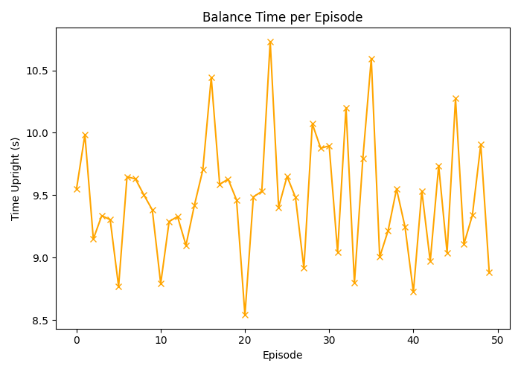
Testing and Evaluation
Other Evaluation Parameters
DDPG Baseline Analysis: Clear evaluation of DDPG performance and limitations in V-REP.
Improved Policies: Advanced DRL (SAC/TD3/PPO) expected to achieve:
Higher success rates
Better path efficiency and speed
Increased robustness and motion stability
Better Sample Efficiency: SAC and TD3 to reach goals with fewer training episodes.
Sim-to-Real Insights: Practical understanding of domain randomization and realistic sensing.
Reusable Framework: Modular, extensible DRL codebase for future mobile robotics research.

Slide 14

Conclusion
Began with DDPG-based mobile robot navigation using V-REP and ultrasonic sensors.
Identified key DDPG limitations: low sample efficiency, hyperparameter sensitivity, and weak robustness.
Proposed upgrading to advanced DRL algorithms: SAC, TD3, PPO.
Integrated training enhancements:
Domain Randomization for robustness
Curriculum Learning for progressive skill acquisition
Sensor Fusion with odometry, vision, or LiDAR
Hierarchical RL for complex task handling
Defined both functional and performance-oriented requirements.
Presented a phased methodology for systematic development and evaluation.
Expected outcomes:
Higher task success rate and Smoother, efficient motion and Greater training stability and real-world adaptability

Slide 15


Impact and Future Directions
Advances in Autonomous Robotics: Enables more robust, efficient, and adaptable mobile robots for real-world tasks like logistics, inspection, and exploration.
Path to Real-World Deployment: Emphasis on domain randomization and realistic sensing supports future sim-to-real transfer.
Educational Contribution:
Serves as a practical case study in applying and scaling DRL for robotics, useful for students and researchers.
Stimulates Further Research: Raises key questions on:
Automating curriculum learning
Optimal sensor fusion architectures
Safety in DRL for robotics
Limits of domain randomization vs. online adaptation
Interpretability of learned policies

Slide 16



Thank You!

